Slide 1
QAD Data?? We’ve been dealing with it since 1998, have more than 100 sites and handle it
BRILLIANTLY

Slide 2
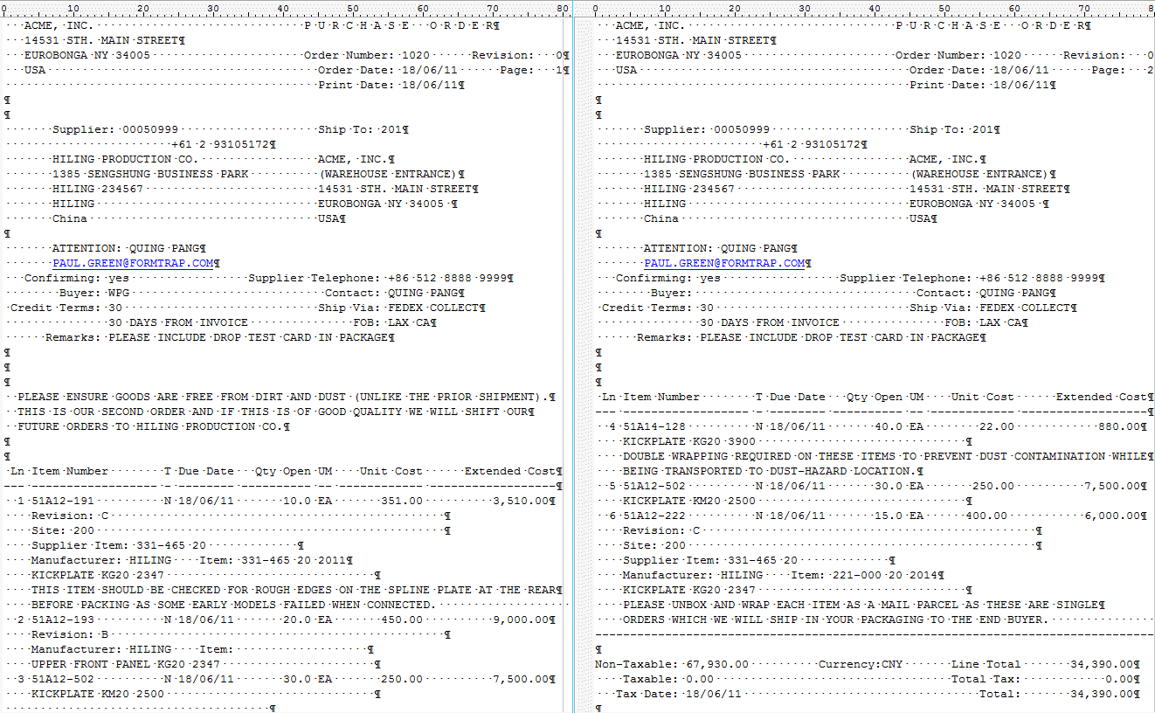
We start with QAD Standard Output – these two Purchase Order pages …

Slide 3
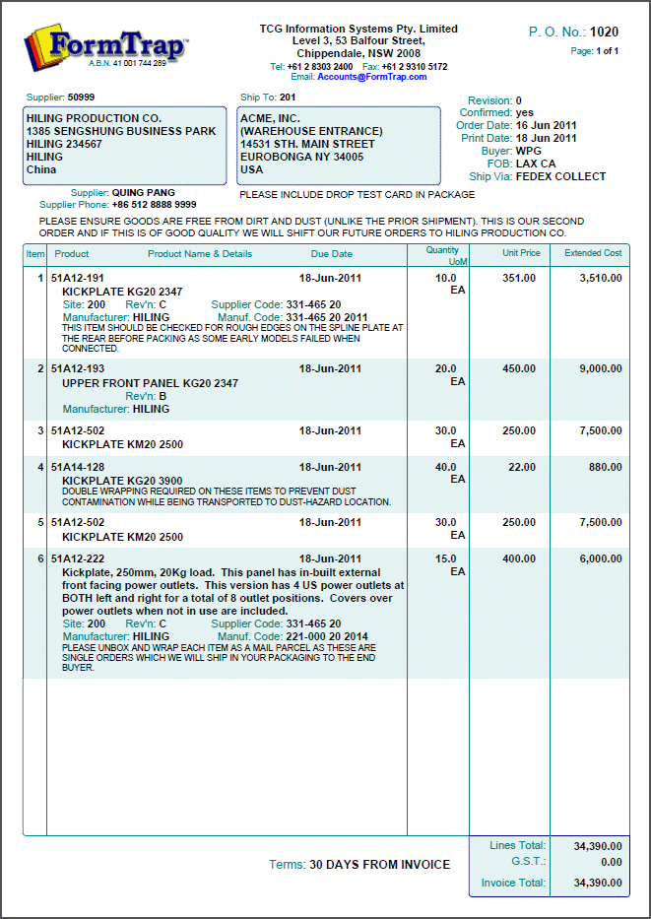
Header is variable size because of …
Invoice header is also variable height
… these (optional) header comments
This is the first output page …

Slide 4
We ignore these …
… and instead use lookups
(or you use QAD output)
… 2 lines out
3 lines in …

Slide 5
Details are also variable size due to …
Small amounts of variable data …

Slide 6
3 comment lines out
Large amounts of variable data …
… plus 2 optional comment lines

Slide 7
This shows a lookup replacing abbeviated product description. We’ve yet to see ANY system that doesn’t abbreviate the MEANING from product descriptions.
We build this into EVERY form. If there is no lookup, we use system description.
This means you can QUOTE directly from your QAD output, rather than having to use Word processing so your customers understand what they’re quoted.

Slide 8
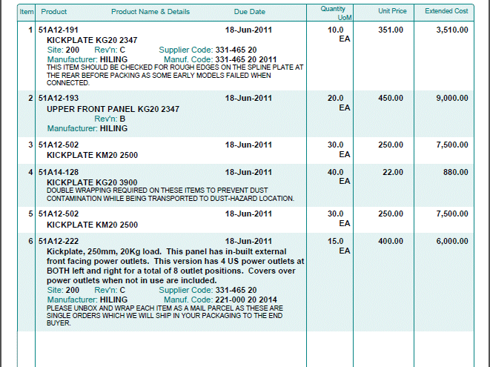
This detail line has everything
… while this has the minimum
This one is the largest
We can half-shadow details

Slide 9
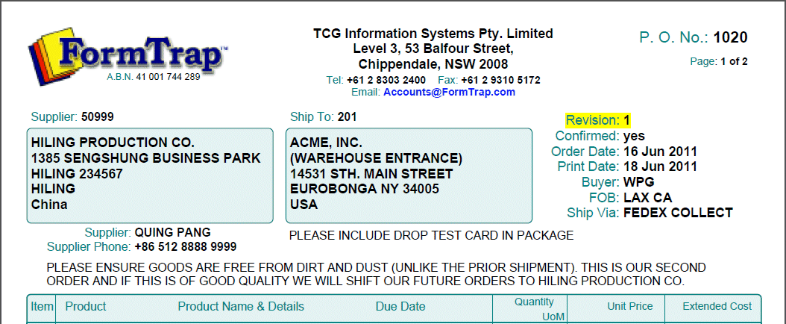
This is the Report Header (Page 1)
This is the Page Header (Pages 2 and onward)

Slide 10
Note these …
Variable height …
Context only …
Fixed height …

Slide 11
This is the Page Footer (all pages except the last)
This is the Report Footer (last page)
This is space recovered
This is information and space only when required

Slide 12
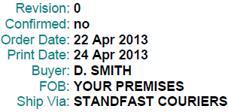
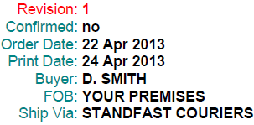
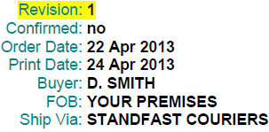
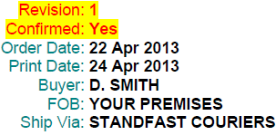
This is ONE object, aligned at the colon
Show what is important with color …
… or by highlighting
… or BOTH

Slide 13
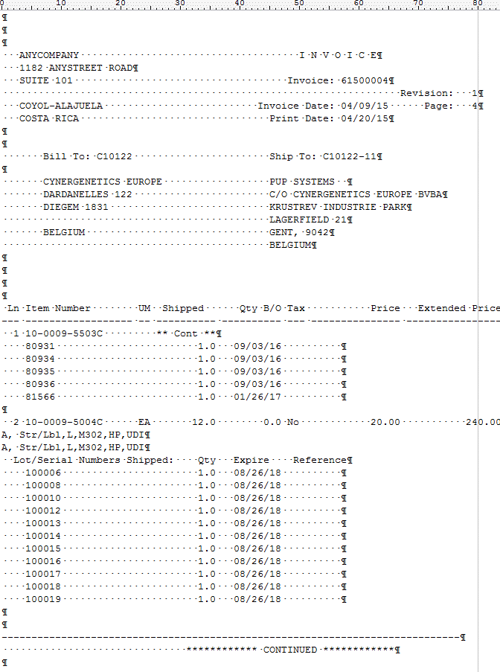
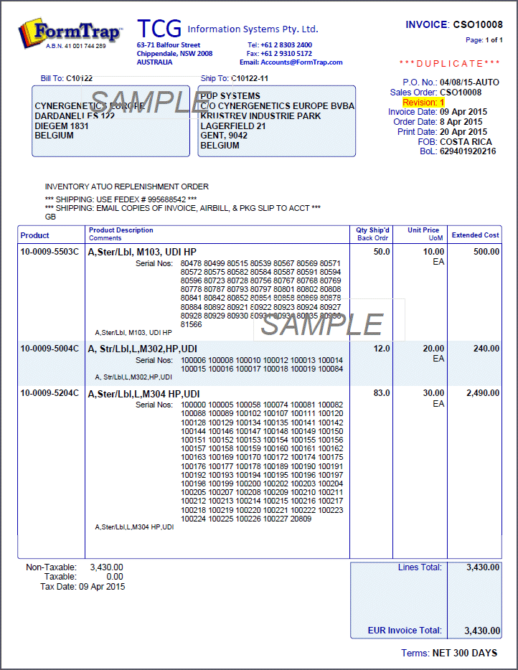
This is Page 4 of 9 with each serial number on it’s own line …
SPECIAL TRICKS-OF-THE-TRADE
Result, all on ONE page …
… down from NINE pages.

Slide 14
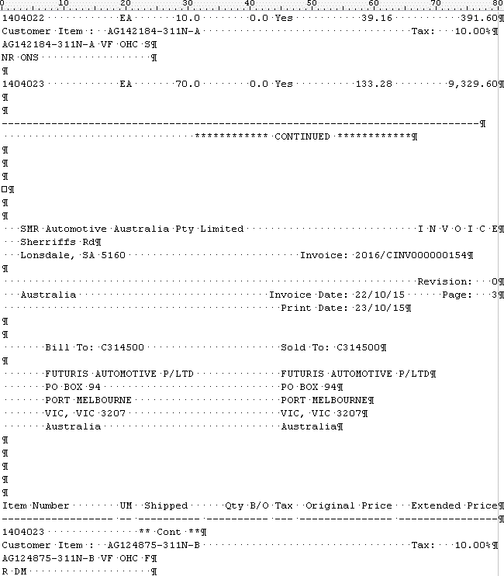
This is Product splits across pages …

Slide 15
… and is rejoined on one line here …
… with input two lines re-assembled.
Current, Automotive customer in Australia

Slide 16
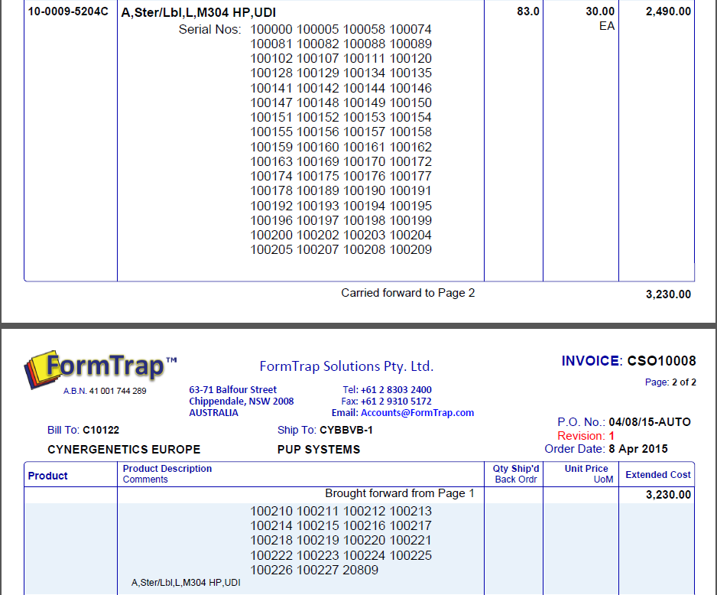
… while this shows FormTrap splitting a long product over two pages

Slide 17
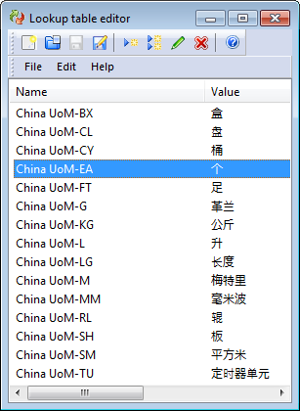
QAD Overseas
Show dates and numbers to that county’s preferences
Translate from one to another
Translate what QAD doesn’t using Lookup Tables, this is QAD-UoM to Chinese …
… do the same with Payment terms from Payment Code

Slide 18
… Use in ANY Country
This is a Version 7 form from a current customer ….

Slide 19
There’s More: Delivery to Email, HTML Email, PDF/A, Gmail PDF Reader, Fax and e-Fax, Print, Archive QAD Sell, Install and Support FormTrap, on QAD contracts, in Australia and New Zealand. 95% of QAD’s Aust./NZ sites use FormTrap. We have hundreds of sites and have EVERYTHING you’d ever want. Just ASK …

Slide 20
Existing V7 Customers: Run V7 forms unchanged Want to move to QAD EE Version?? We have standard FormTrap V8 reports ready, ask for samples (You will need to change lookups – and that’s it)

Slide 21
There’s STILL MORE … FormTrap does ALL these, go here to look for specific PowerPoints: http://www.formtrap.com/promotions/powerpoints/ Barcode printing that runs to ANY printer, including barcode printers Letters, particularly Debtors Letters Full and pervasive Lookup substitution into forms HTML Customer replies to emailed complaints that is fast, specific and WORKS Contract Writing (insurance companies) Letter Writing (insurance companies) HTML Email (for ICWI insurance company) Input data from ANY text / PDF /XML / CSV file, incl. products split across pages QDE (Quick Data Entry) which AUTOMATICALLY defines a .net keying session for unconnected, remote use and/or within FormTrap Server Any language – including Chinese, Japanese, Thai (and all European) Formatting conventions for amounts and Qty, automatic translation of dates Linux versions (Red Hat and Debian) for resellers … and defined and coming soon … Low cost Windows Production module for the very low volume, where the user initiates print and email runs Exceptional Volume module for the very high end (banks, utilities)

Slide 22
Thank you for watching …
Sales@FormTrap.com
Support@FormTrap.com
+61 2 8303 2400

