Slide 1
Stuck with
old technology
AS/400 runs your data, BUT the OUTPUT looks absolutely
DREADFUL
and costs between $1.00 and $3.00 per transaction
delivered by the Postman

Slide 2
Insurance HTML Email
Provides the Solution
with
HUGE FINANCIAL BENEFIT

Slide 3
From this:
I’m going to show FormTrap outputs …
… from which you can draw your own conclusions
Financially, this is THE MOST
rewarding project you’ll have,
in this generation

Slide 4
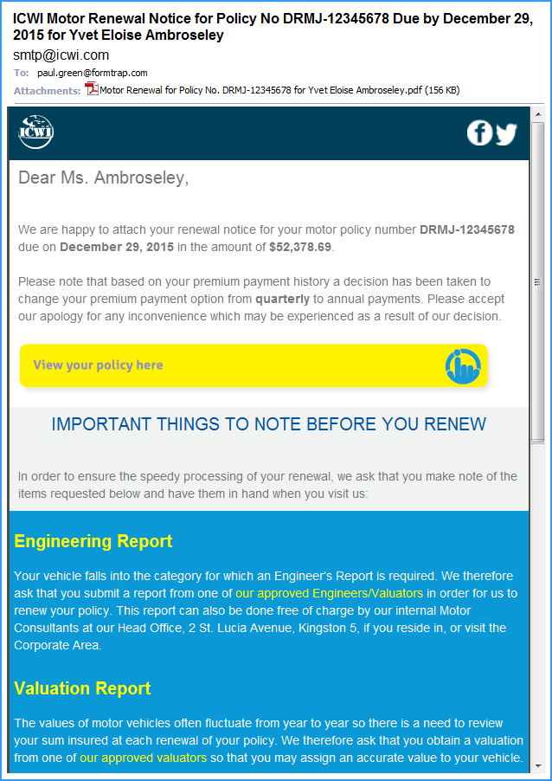
Titles from the Data
Data inserted here
These access web site documents and lists for instant self-service
The entire Engineering Report block is conditional
… but wait, there’s more …

Slide 5
This …

Slide 6
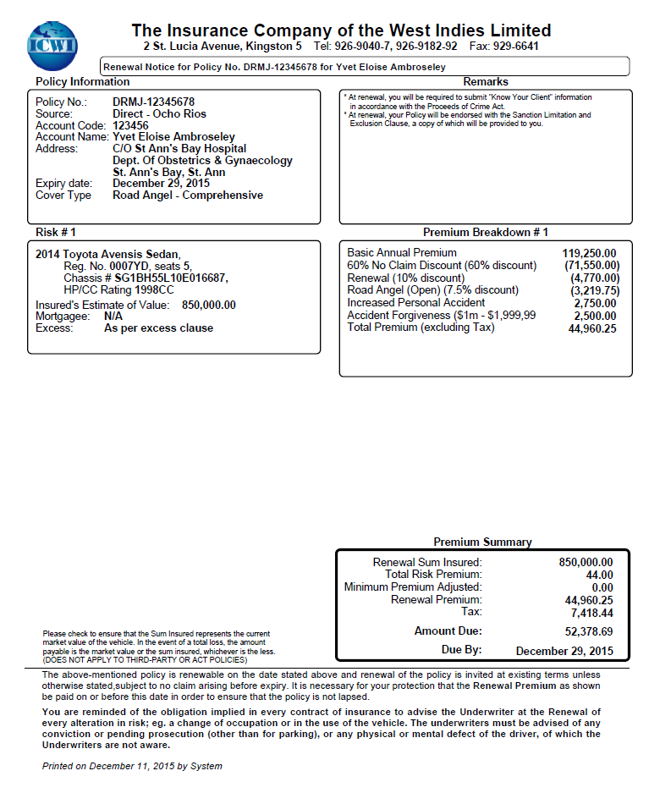
… is the attached PDF
… and there’s STILL
more …

Slide 7
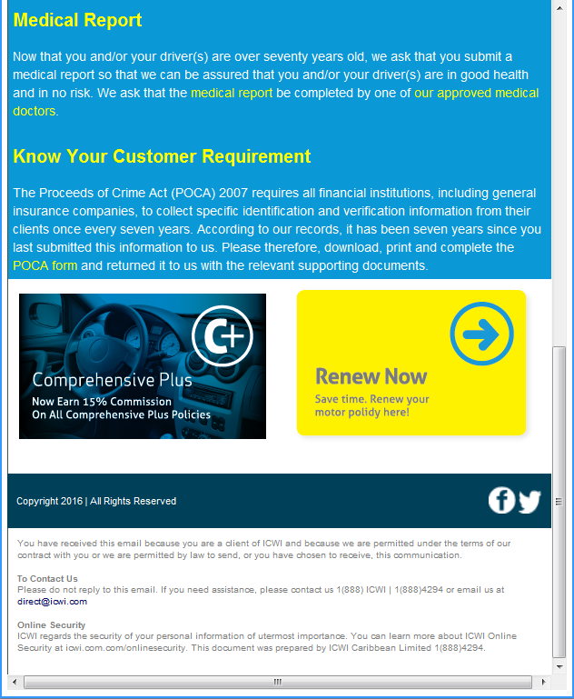
The entire Medical Report block is conditional
This entire block is conditional
… and these are MONEY MAKERS. No people or cost for Renew Now
… web site selling for Comprehensive Plus

Slide 8
This went into production in 2016
It took FormTrap TWO YEARS to convince ICWI to “bite” and upgrade (they’ve been a FormTrap user for more than a decade) they only did once we showed HTML Emails with variable inserts.
It took just three months to be tested and ready for production in 2016

Slide 9
… and they are saving
2 Million
Jamaican dollars per year

Slide 10
Call or Email us …
Sales@FormTrap.com
Support@FormTrap.com
+61 2 8303 2400

