Slide 1
Form Library for
Outputs

Slide 2
Do I need to do anything
FormTrap is a two-stage system
Stage 1 converts data to XML format
(QXtend files may be also be simply converted to FormTrap XML)
QAD formats (output is IDENTICAL XML):
SE reports
EE reports
Data Extracts (Australia & NZ)
QXtend
Stage 2 formats from the identical XML file
No you don’t …

Slide 3
Email addresses
Email is normally missing from std. reports:
Option 1. Change the std. report to include
this as the first Header Comment or similar
Option 2 use lookups based on customer no.
Extract from your DB nightly
Ask us for the Lookup Table update
How lookups work is shown later …
Yes you do …

Slide 4
QAD Example
Purchase Order
This is available for use instantly, just ask, then change the Lookups for Company Name

Slide 5
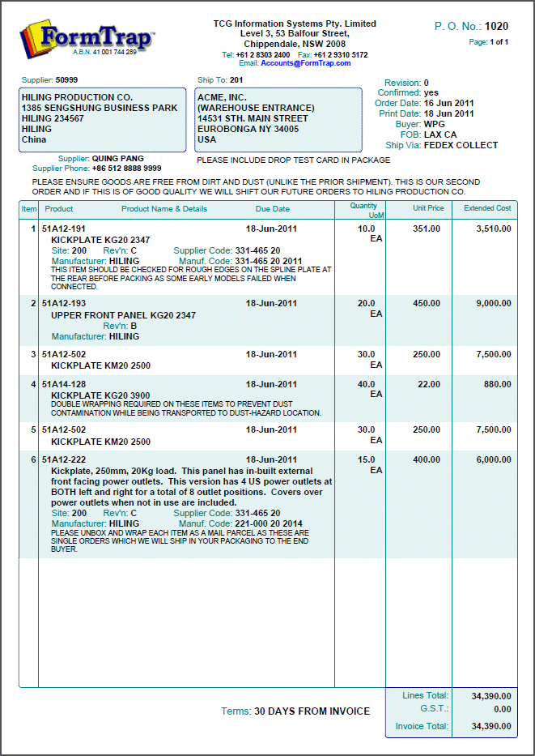
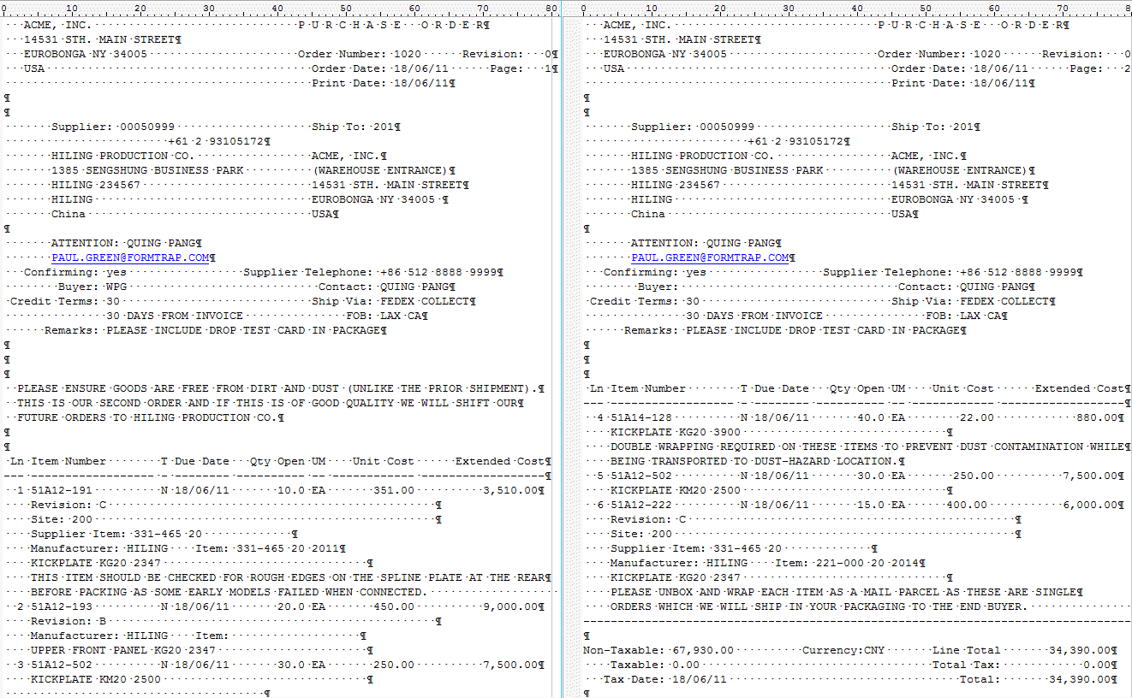
Header is variable size because of …
Invoice header is also variable height
… these (optional) header comments

Slide 6
We ignore these …
… and instead use lookups
… 2 lines out
3 lines in …

Slide 7
Details are also variable size due to …
Small amounts of variable data …

Slide 8
3 comment lines out
Large amounts of variable data …
… plus 2 optional comment lines

Slide 9
This slide shows a lookup facilities for product description. We’ve yet to see ANY system that doesn’t abbreviate the MEANING from product descriptions.
How much better does this look …
… we have this in all of the forms we supply. Use it only if you want to. No lookup??
KICKPLATE KG20 2347 is printed
… system data
This means you can QUOTE directly from your QAD output, rather than having to use Word processing so your customers CAN understand what they’re quoted.

Slide 10
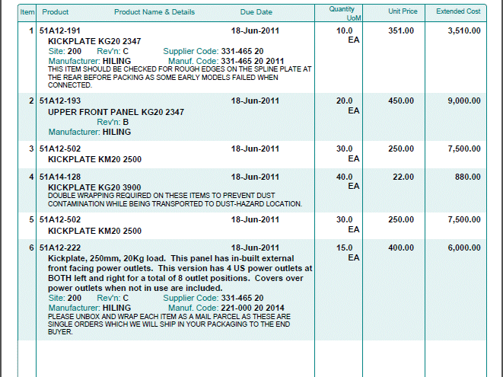
This detail line has everything
… while this has the minimum
This one is the largest
We can half-shadow details

Slide 11
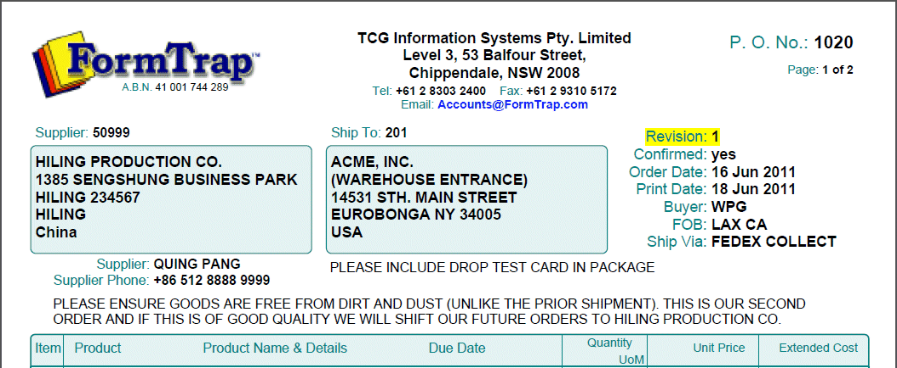
This is the Report Header (Page 1)
This is the Page Header (Pages 2 and onward)

Slide 12
Note these …
Variable height …
Context only …
Fixed height …

Slide 13
This is the Page Footer (all pages except the last)
This is the Report Footer (last page)
This is space recovered
This is information and space only when required

Slide 14
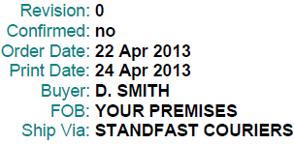
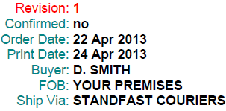
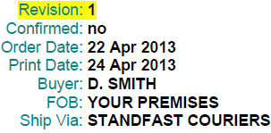
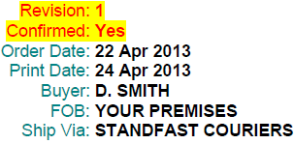
This is ONE object, aligned at the colon
Show what is important with color …
… or by highlighting
… or BOTH

Slide 15
This is an invoice …

Slide 16
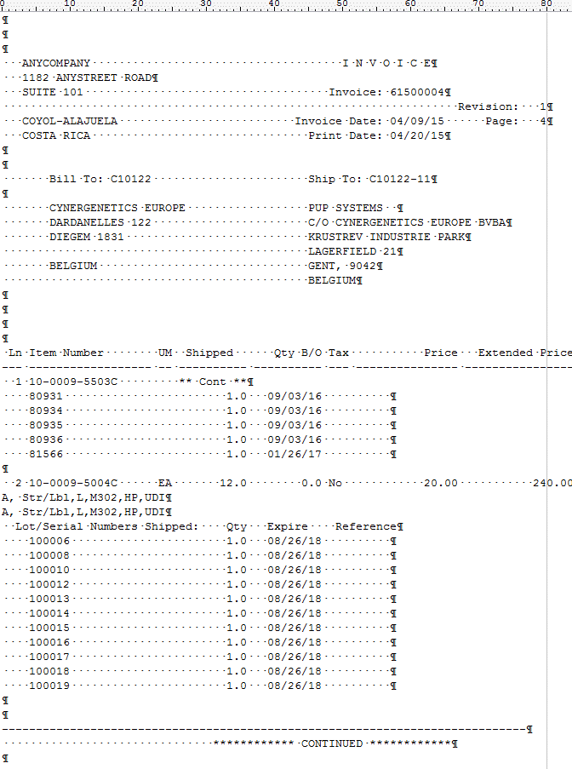
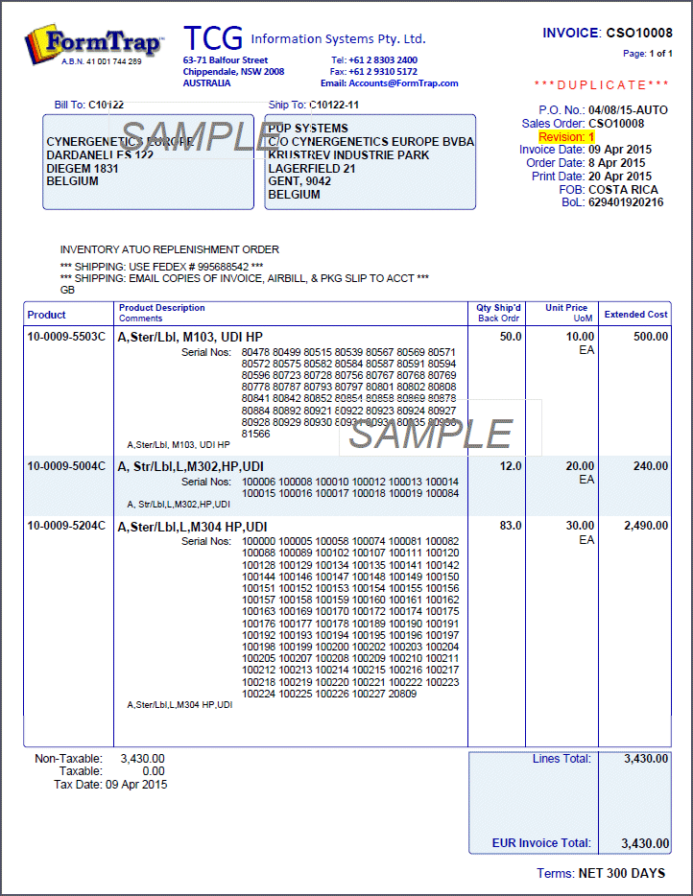
This is Page 4 of 9 with each serial number on it’s own line …
… plus one from the next page
SPECIAL TRICKS-OF-THE-TRADE
This is an invoice …
Result, all on ONE page …
… down from NINE pages.

Slide 17
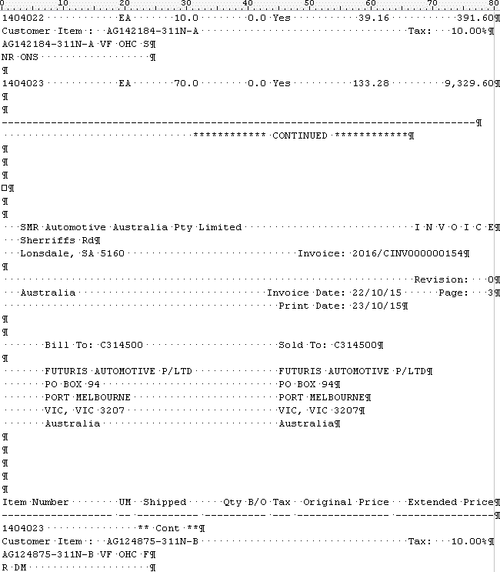
This is Product splits across pages …

Slide 18
… and is rejoined on one line here …
… with input two lines re-assembled.
Current, Automotive customer in Australia

Slide 19
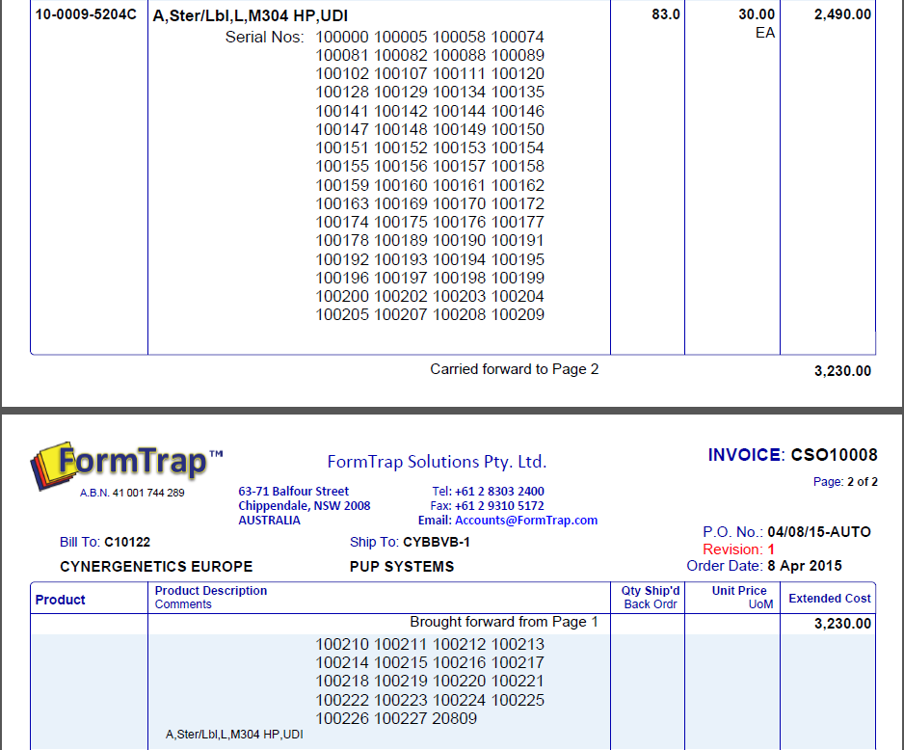
… while this shows FormTrap splitting a long product over two pages

Slide 20
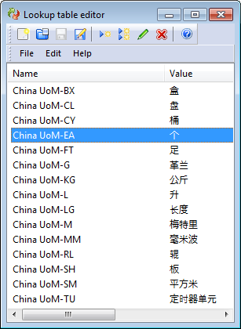
QAD Overseas
Show dates and numbers to that county’s preferences
Translate from one to another
Translate what QAD doesn’t using Lookup Tables, this is QAD-UoM to Chinese …
This is a FormTrap form …
… do the same with Payment terms from Payment Code

Slide 21
… Use in ANY Country
This is a PO form from a current customer ….

Slide 22
This explains Lookups
Lookups allow you to do just about anything
ALL of our forms include Product Lookups, use them only if you want to by generating Lookup Entries – for specific products only if that is what you require

Slide 23
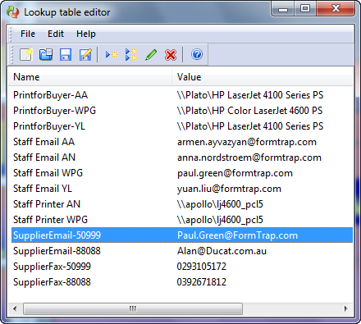
XML Delivery Tag Data
What does XML provide??
Given Supplier ..
… look up and substitute Email.

Slide 24
XML Delivery Tag Data
What does XML provide??
If you look up SupplierEmail-50990 and there is no match …
… you get back what went in. SupplierEmail-50990

Slide 25
XML Delivery Tag Data
What does XML provide??
If the returned value was not found in the table, ie:
contains SupplierEmail-
…then instead email to FixThis@OurCompany.com
The FixThis function will then find out and manually email the supplier AND fix the DB for next time.
Your processing is uninterrupted, in fact it is an improvement over standard operating procedures ...

Slide 26
XML Delivery Tag Data
What does XML provide??
… other uses for FormTrap lookups:
Delivery to email, fax, printer
Language translations not covered: e.g. UoM and Payment Terms in Chinese
Full letter phrases from an abbreviation
Company demographics from code or Company Name
Expanded product name (or the system field if there is no lookup for this item)
Press here for details

Slide 27
Bar Codes were included from
the very first version
of
FormTrap

Slide 28
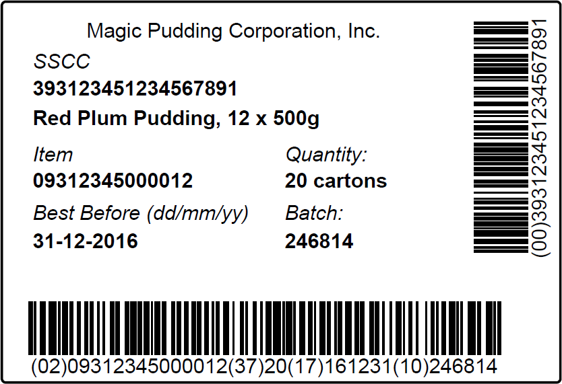
Barcodes
FormTrap properly formats SSCC Codes
Taking AI’s into account and checking data. FormTrap will NOT format an improper SSCC (EAN/UPC-128) barcode.
FormTrap operates on delimited or full data and automatically compresses the barcode
WITHOUT YOU DOING ANYTHING.
FormTrap brackets (AI) automatically

Slide 29
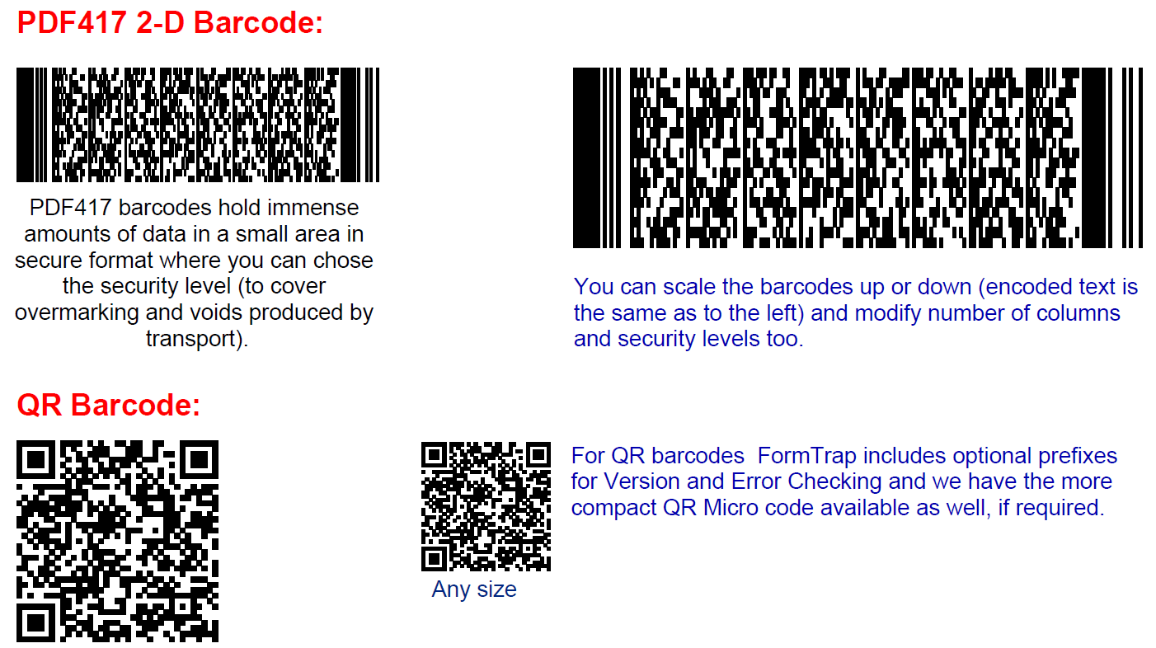
Barcodes
FormTrap has 2-D Barcodes, with ALL Options .

Slide 30
Barcodes
JUST ASK if you don’t see what you require, we can do it for you.
Automatically email a PDF’d file of barcode labels to your SUPPLIER with your PO. They can print via Windows on ANY printer and place on YOUR goods, using YOUR format.
… one more job done RIGHT, with zero human involvement, just the one Email and one less program …

Slide 31
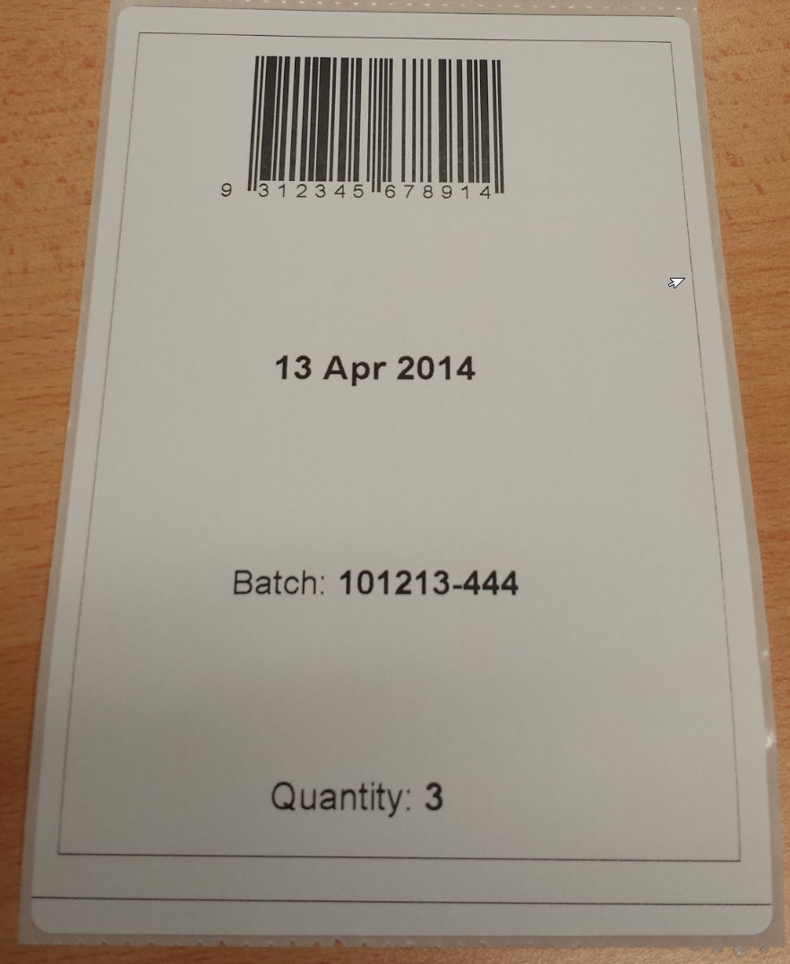
Barcodes
Last of three labels formatted at FormTrap, sent as a PDF, printed via Windows to a Zebra ZM400 on A6 stationery.
For the full Barcode PowerPoint Press here

Slide 32
… but there’s more
Use the QDE program to instantly produce barcodes as PDFs, from a simple keying session,
then print to a Windows-defined label printer.
Nothing could be simpler …
QDE is $200 per computer seat for one year, this is the only additional cost item in this presentation

Slide 33
… and there’s even more
Embed barcodes in ANY of your business documents,
… use to save keystrokes on returned documents,
… use so your pickers can scan a code rather than keying,
… use to check stock barcode is the same as ordered barcode,
… use to index scanned documents,
… and so on …
Barcodes included FREE with all FormTrap Systems, and in one and the same operational environment as business documents.

Slide 34
This shows HTML output from FormTrap.
It’s from an insurance company,
however
You’ll get the picture …

Slide 35
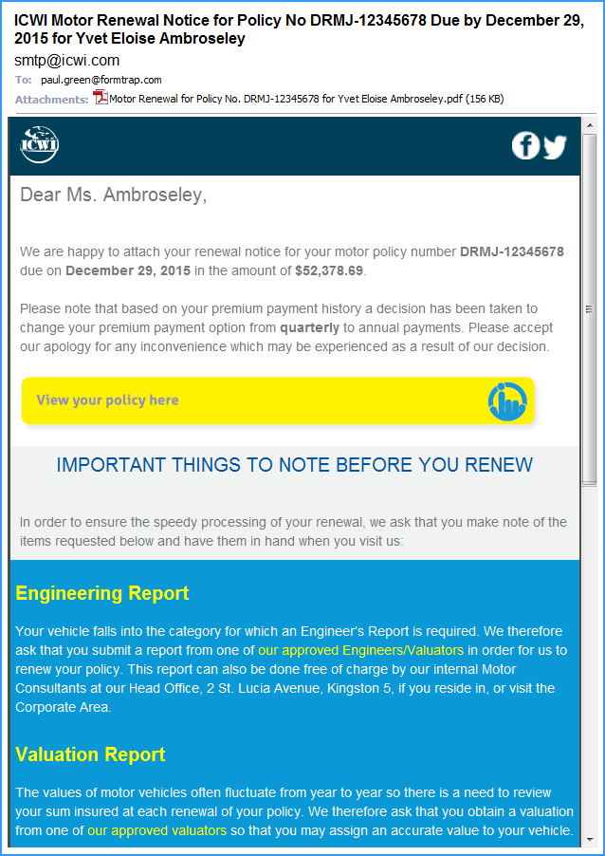
Titles from the Data
Data inserted here
These access web site documents and lists for instant self-service
The entire Engineering Report block is conditional
… but wait, there’s more …

Slide 36
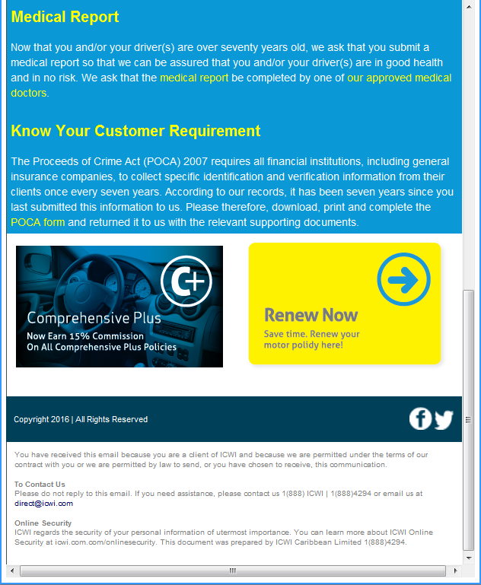
The entire Medical Report block is conditional
This entire block is conditional
… and these are MONEY MAKERS. No people or cost for Renew Now
… web site selling for Comprehensive Plus

Slide 37
FormTrap allows Informed Decisions so you can select the emailed PDF
Business to Business
“PDF-A” , inclusive of the font glyphs
(up to 1Mb in size, any font)
Gmail, iPhone, iPad, poor band width – minimum size (under 30Kb incl. logo, restricted fonts)
Image PDF, VERY hard to modify or tamper with
(approximately 60Kb, cannot search)

Slide 38
Finally …
A few Samples from FormTrap
some are on A4 paper
however
very quickly amended to Letter

Slide 39
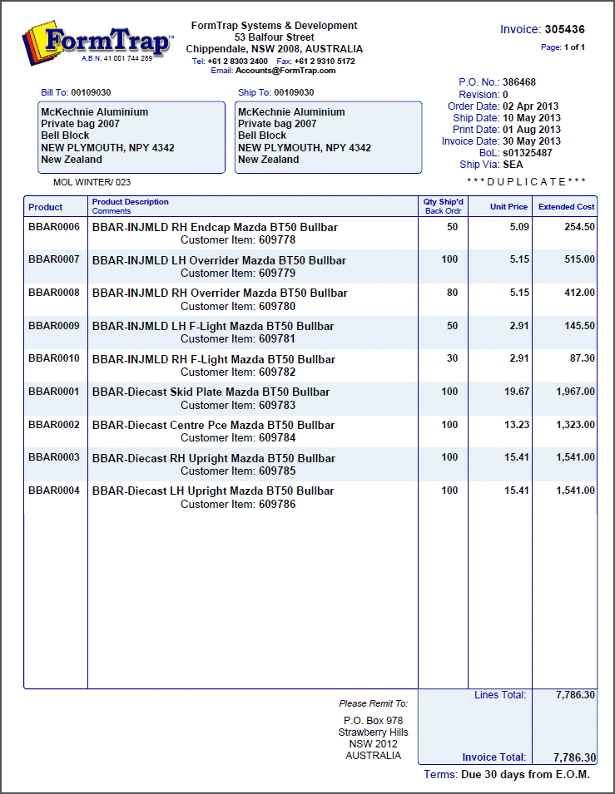
Portrait Invoice …

Slide 40
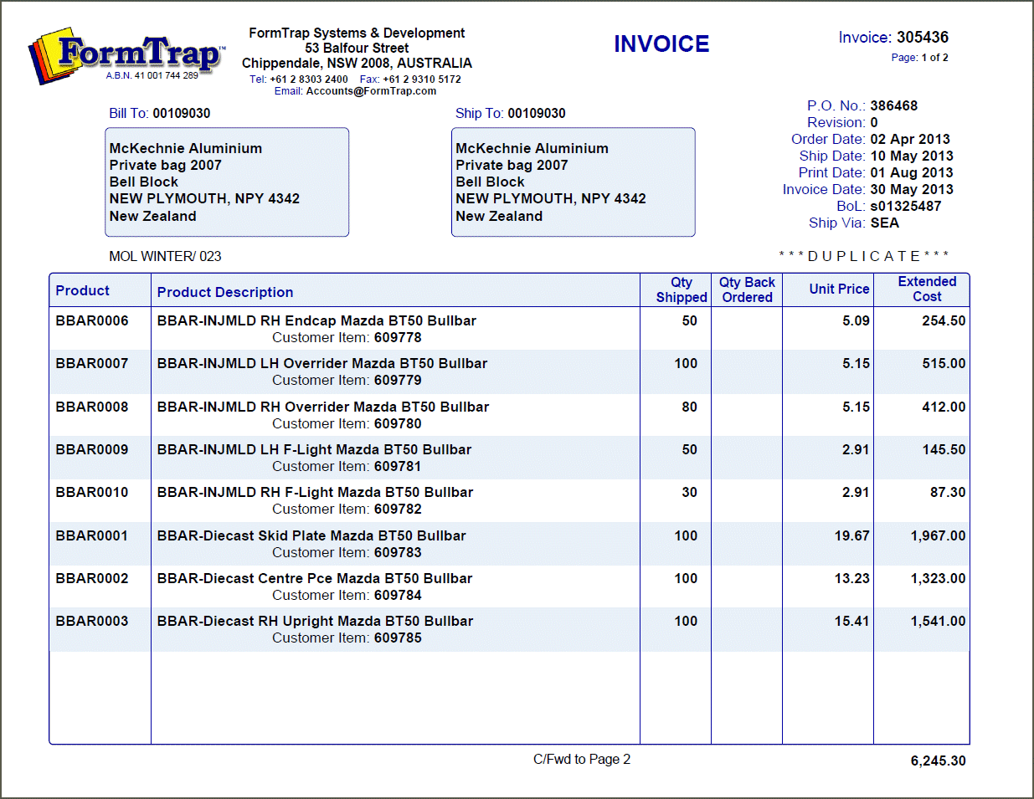
… as well as Landscapeit

Slide 41
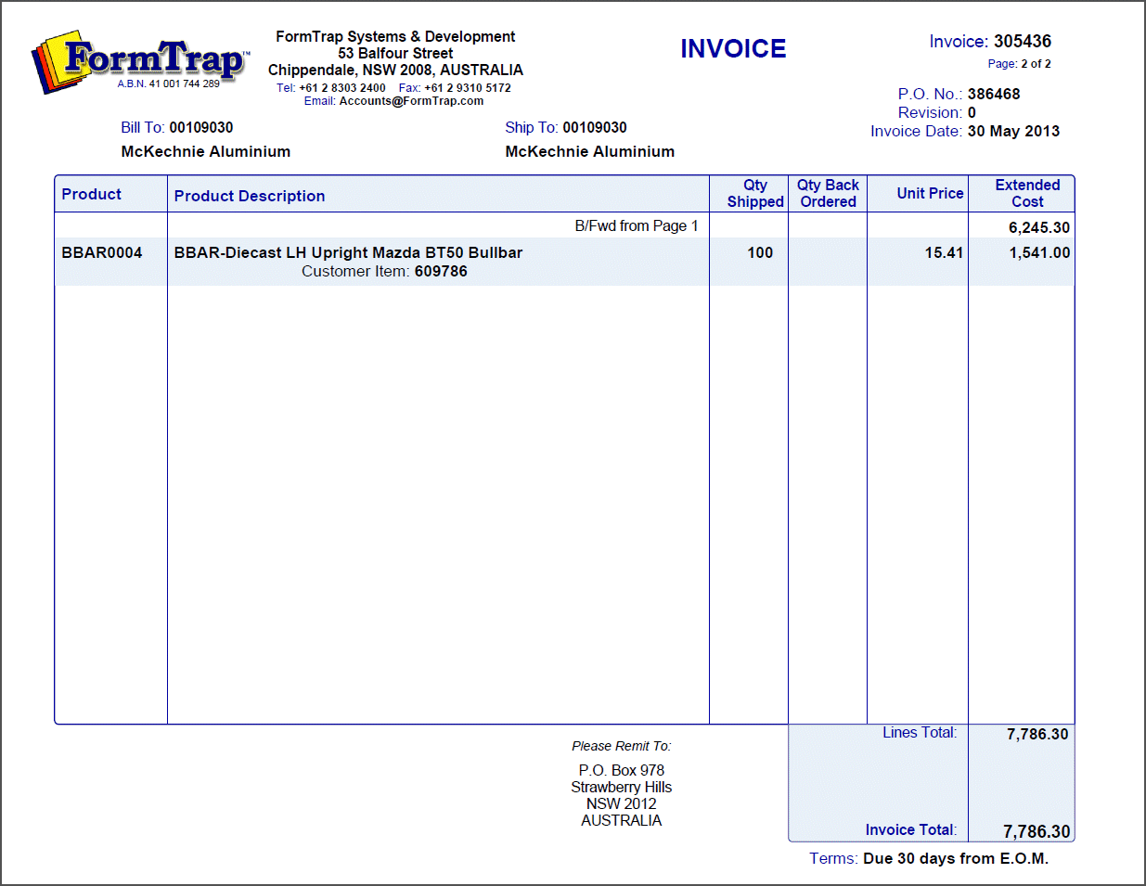
This is the final page with totals

Slide 42
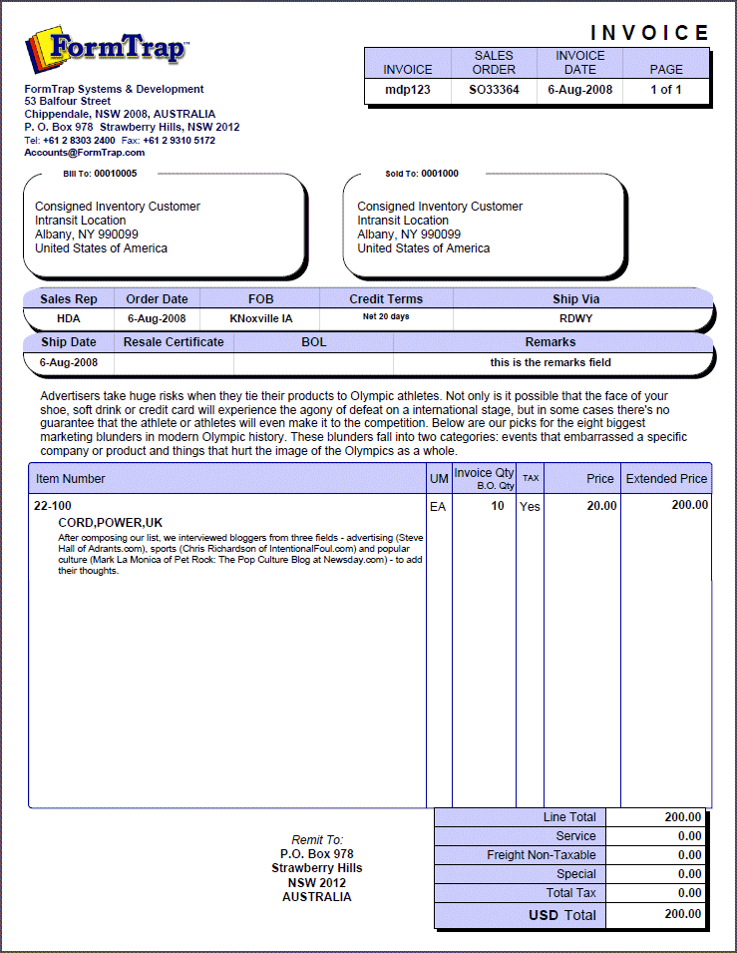
Shows what can be done with a little imagination.

Slide 43
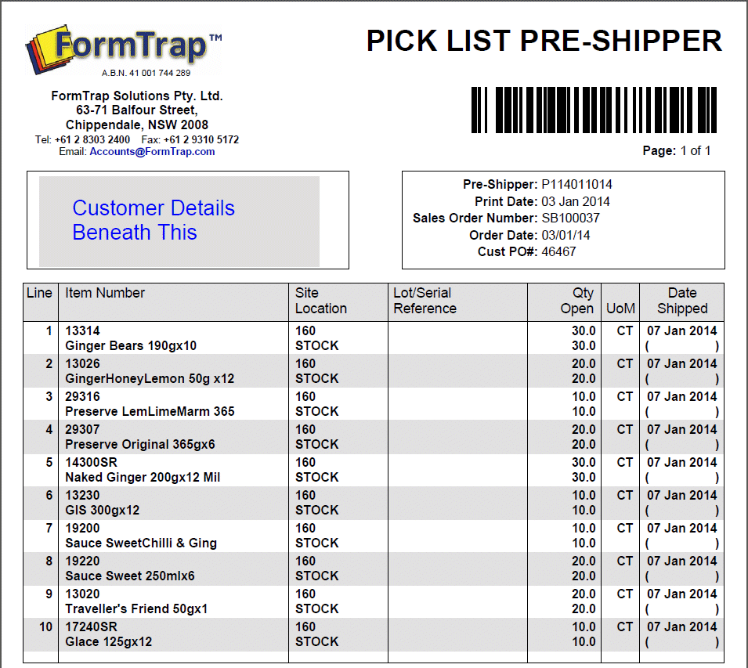
FormTrap demographics inserted automatically from Lookups.
Printed in B&W, Customer Design.

Slide 44
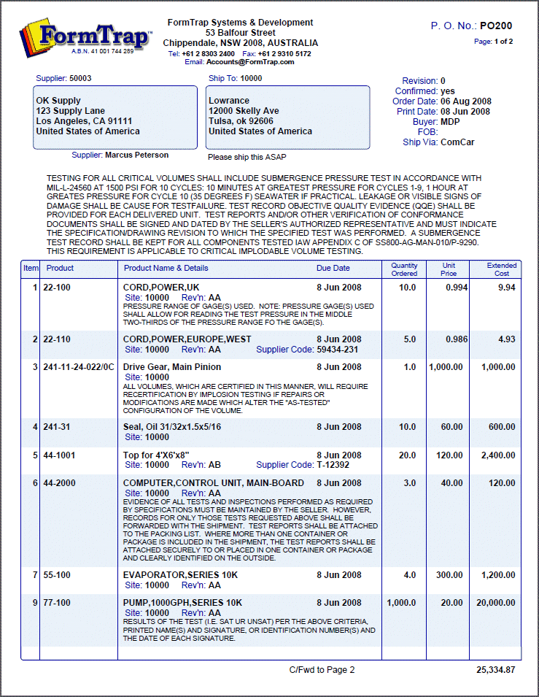
FormTrap handles sometimes there, sometime not data exceptionally well …

Slide 45
Comments may optionally be concatenated and the lines re-wrapped

Slide 46
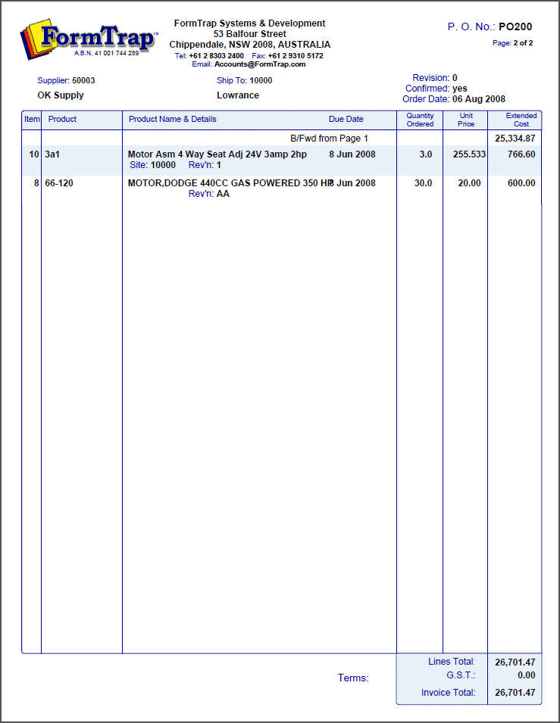
Final page with totals

Slide 47
Available documents
Invoice Formats:
Sales Order confirmation
Preview Invoice
Invoice / Debit Adjustment with serial numbers with lots
Credit Note / Credit Adjustment
Purchase Order
Picking Slip
Packing Slip
Goods Despatch
Work Order
Statement

Slide 48
Why would you Buy
Over a decade of experience with QAD forms, well over 100 sites
Facilities that allow direct input of ANY QAD format, including QXtend
Extensive Bar Codes, incl. SSCC, PDF 417, QR
Full set of forms, from standard reports, in ANY language including Chinese, Japanese etc. Running within a week if we have models here.
HTML Email output, includes data lines for Promos
Options for emailed PDFs for Gmail and iPad/iPhones to read them very efficiently in proportional fonts
Full lookup facilities for product names, company demographics etc.
Full fail-safe pre-archive of all processes, with recovery in the event of a failure
Server functions, up to Windows Server 2012, R2, 64-bit executables, in a VM. Customer testing of Windows Server 2016 scheduled for April.
You get EVERYTHING shown in this presentation with FormTrap

Slide 49
Thank you for watching …
Sales@FormTrap.com
Support@FormTrap.com
+61 2 8303 2400

